Slide 1


Trending Youtube Exploration
By: Mohamad Nayal & Gary Chen

Slide 2


Data Sources:
Trending YouTube Video Statistics
Primary Source for our project
From Kaggle - (data points range from November 14, 2017 through June 14, 2018)
Data from the top trending YouTube videos from 10 countries
(Canada, Germany, France, Great Britain, India, Japan, South Korea, Mexico, Rusia, & United States)
Income by Country
Provided the 2018 Gross National Income per capita
From Kaggle - (used to explore if GNI affects which videos trend)
Official Languages By Country
Scraped from Wikipedia page of official language by country
Used to group countries that speak the same language
Notes:
Scraped wiki pages

Slide 3
Cleaning
Noticed that some videos were trending for multiple days in a row which resulted in multiple entries for the same video
Created a function to parition and rank entries from each country with the most recent trending date as rank 1. (latest to earliest video)
Original Youtube Dataset had 363,372 records
Dataset with just the latest entry had 200,667 records
Our Language dataset was very messy after we scraped it from the Wikipedia page
Had to build a dictionary and do some manual cleaning
Turned the dictionary into a list to get the official language of each country

Slide 4
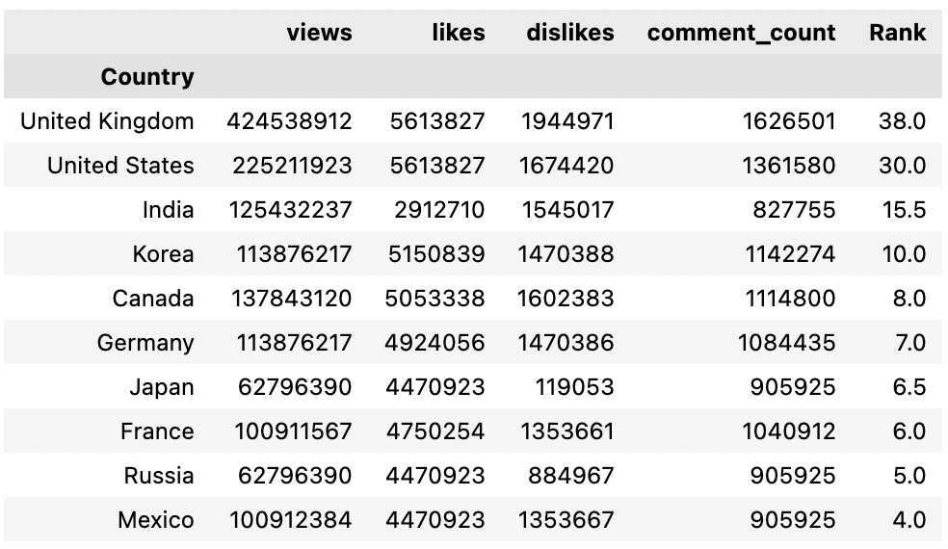
Top Trending Video Durations

Slide 5
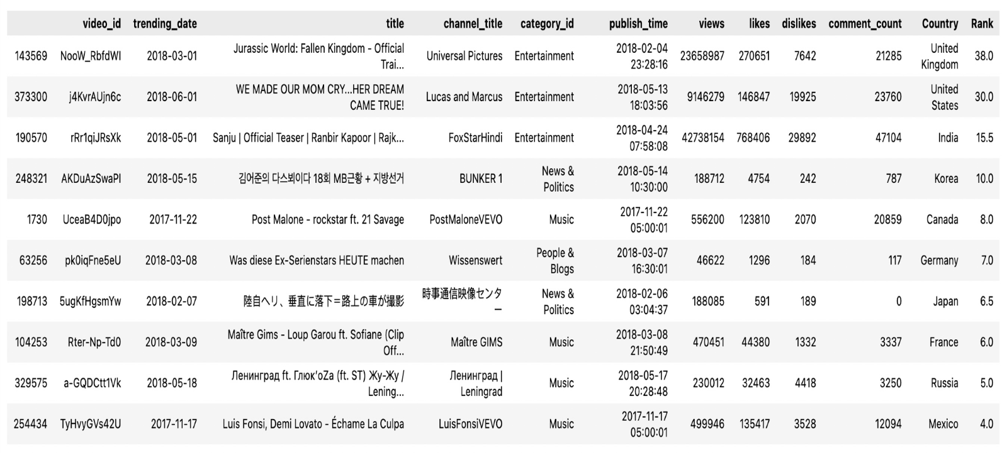
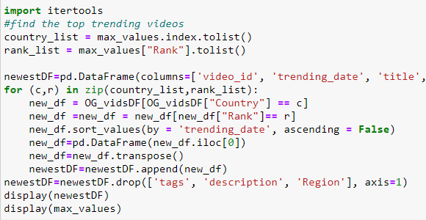
Longest Trending Videos

Slide 6

Analysis Questions
Question 1: What are the most used words used in the titles of trending videos?
Question 2: What categories are the most popular for each country?
Question 3: Does the wealth (GNI) of a country influence what type or category of videos trend?
Question 4: What combination of words in what category would help a title to trend globally?
Question 5: Do more trending videos contain a positive or negative image of Trump?

Slide 7
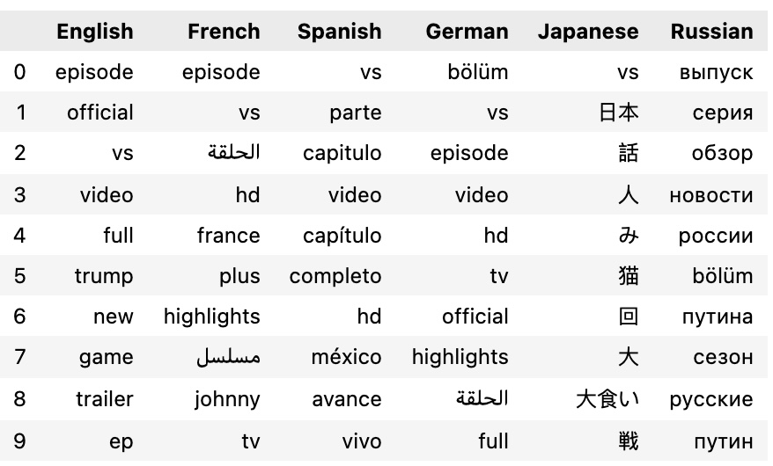
Title words bY language
English | French | Spanish | German | Japanese | Russian
episode | episode | vs | episode | vs | release
official | vs | part | vs | Japan | series
vs | episode | episode | episode | Talk | overview
video | hd | video | video | Man | news
full | france | episode | hd | Fruit | Russia
trump | plus | full | tv | Cat | episode
new | highlights | hd | official | Times | путина
game | johnny | méxico | highlights | Big | сезон
trailer | Tv show | trailer | episode | Gluttony | русские
episode | tv | live | full | Battle | путин
Used NLTK tokenize to create tokens for each language
Tokenized Japanese using re and fugashi
Removed Japanese stopwords from Github repository and manually removed more stopwords

Slide 8

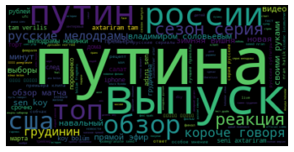
Words Is Art

Slide 9
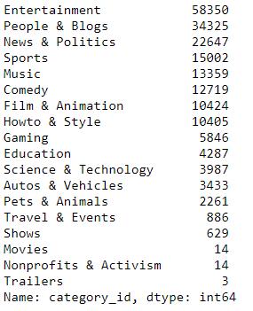
Popping Categories
Outliers:
Education for India,
Pets & Animals for Japan,
Howto & Style for USA
Entertainment
People & Blogs
News & Politics
Sports
Music
Comedy

Slide 10
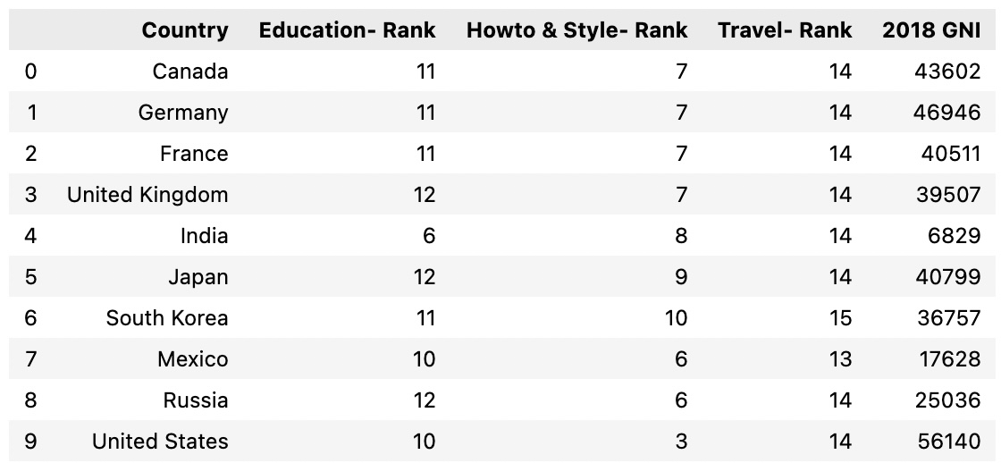
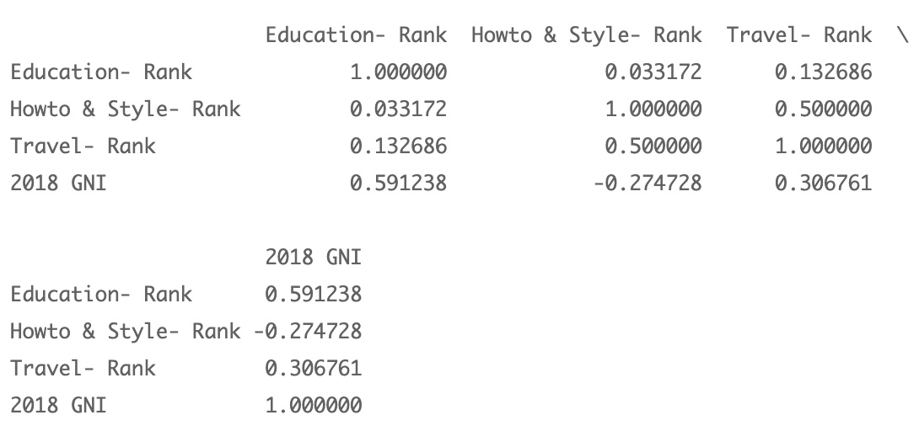
GNI vs Category
Richer countries watch more Howto & Style videos while poorer countries watch more Education videos
Travel videos are rank very low across all countries

Slide 11
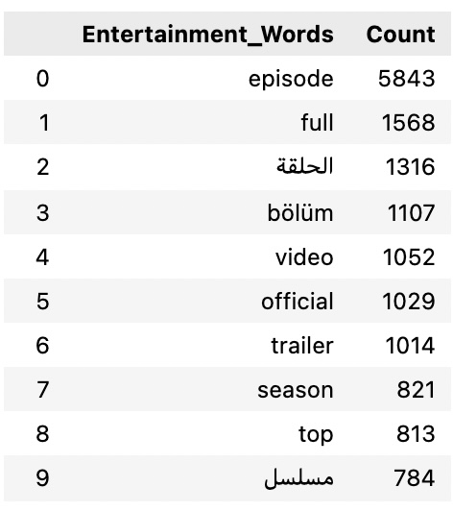



Slide 12
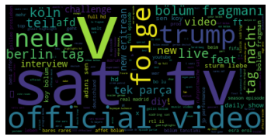
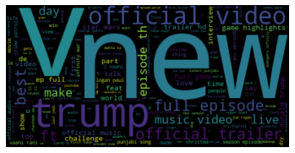
Visual Trends

Slide 13

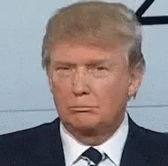
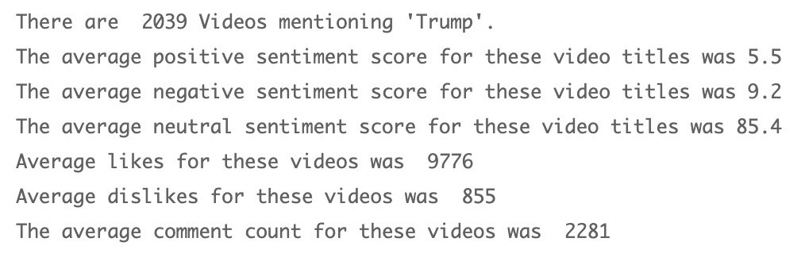
"Trump" Sentiment
​ | Positive​ | Negative​ | Neutral​ | Likes | Dislikes
Trump​ | 5.5​ | 9.2​ | 85.4​ | 9776 | 855
Control​ | 3.5​ | 3.1​ | 93.5​ | 15977 | 967
Notes:
Nltk sentimentIntesnityAnalyzer

Slide 14

Conclusions
People come to YouTube for episodic content
The most viewed videos throughout the world are usually music videos
The top 6 categories are globally consistent
GNI of a country can have an influence on the lower ranked categories
To make a video trend use the words official, episode, trailer, versus (vs. / v.)
Politics is more divisive than other topics but doesn't get nearly as much attention and likes

Slide 15
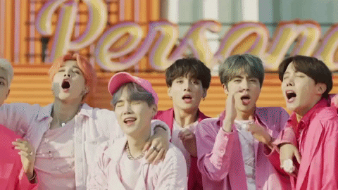
FUn Fact: KPOP IS taking over the world
BTS videos were in the top 10 of most liked trending videos across the world.
Canada, Germany, France, UK, Japan, South Korea, Mexico, Russia, USA all have mad love for BTS
THE END!!

